Slide 1
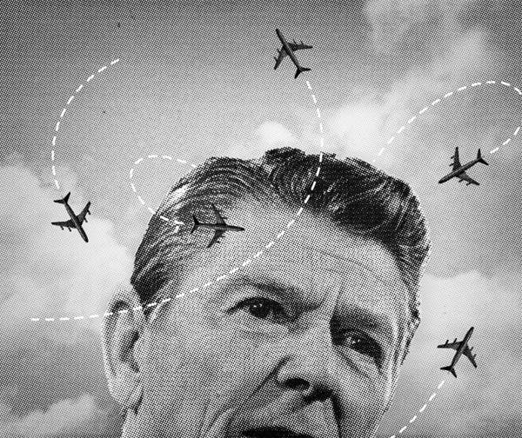
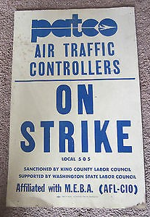
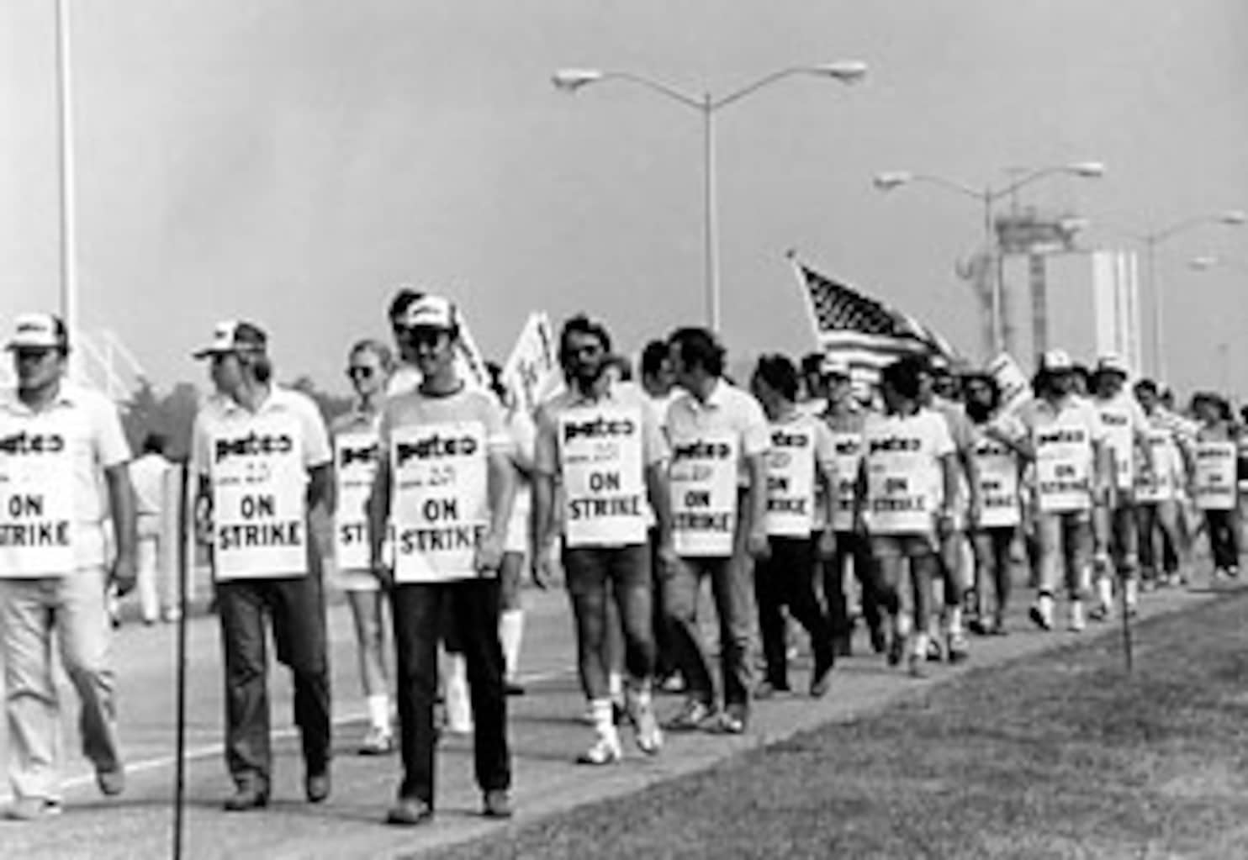
THE PATCO DEBACLE WHO’S TO BLAME?
American Federation of Government Employees Workshop August 3rd, 2022
Judy Ancel, Labor Educator

Slide 2
The patco strike august 3, 1981
Over 12,000 professional air traffic controllers walked out after voting down the negotiated offer recommended by their leaders.
They believed they could shut down air traffic and force President Reagan to give them a better deal
As federal employees, their strike was illegal
Reagan, who was still on his presidential honeymoon, gave them 48 hours to go back to work and then fired 11,350 controllers and blacklisted them from federal employment for life
PATCO was destroyed as a union

Slide 3
The impact went well beyond patco
It was a major turning point for workers in U.S. history.
The start of four decades of union busting in both the private and public sectors.
The loss of the strike weapon
It showed that labor was a paper tiger
The breaking of the middle class

Slide 4
https://www.bls.gov/web/wkstp/annual-listing.htm#annual-listing.xlsx.f.4

Slide 5
Could it have been different? There are many questions to answer?
Why didn’t Reagan go back to the bargaining table after PATCO members overwhelmingly rejected a proposed settlement?
What if we’d had a general strike?
Why didn’t we have a general strike?
Why didn’t the Pilots and Machinists shut down air traffic?
Why didn’t the controllers go back to work rather than be fired?
Why was there so little solidarity?
Did Reagan have to fire and blacklist everyone?

Slide 6
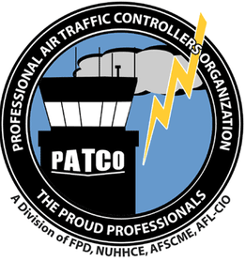
A Video introduction to the strike
The Strike that Broke Unions - Reagan vs. PATCO // Diving In (first 15:40 minutes) https://www.facebook.com/watch/?v=1210034139397144
Reagan Announcement (optional) https://www.facebook.com/watch/?v=3119412868106520

Slide 7
We’ll divide into three groups
PATCO, its leaders and members
President Reagan and the Federal Aviation Administration (FAA)
The Labor Movement, especially the AFL-CIO, ALPA – Airline Pilots Association, and IAM – International Association of Machinists

Slide 8
We’ll Have a Trial – Who was responsible?
Indictment against the Professional Air Traffic Controllers Organization (PATCO) for (1) illegally striking while failing to first win the support of other unions and the AFL-CIO, for (2) the arrogance to think PATCO members were irreplaceable, and for (3) irresponsibly giving a signal to corporations and government that unions were vulnerable to all-out assault, thus causing great harm to workers and the labor movement, which has lasted until the present day.
Indictment against President Reagan, Drew Lewis and the Federal Aviation Administration (FAA) for union busting, firing 11,340 hardworking controllers and banning them from future federal employment rather than negotiating with them over their very legitimate grievances, and for setting off a rash of union busting lasting for years, exacerbated by your administration’s gutting of labor law enforcement and deregulation of workplace safety and a number of industries.
Indictment of the AFL-CIO, its President Lane Kirkland, the International Association of Machinists (IAM), and the Airline Pilots Association (ALPA) as well as other unions for failing to come to the aid of striking PATCO workers in their hour of need, for failing to shut down the airline industry by engaging in sympathy strikes, for hypocrisy of stating support while secretly assuring government that you will not engage in meaningful solidarity, and finally, for failing to insist that the government reinstate fired PATCO strikers.

Slide 9
How to Proceed
Each group must respond to the indictment against it in an open hearing by arguing for their innocence and placing the blame somewhere else. Then we will take questions and challenges from the prosecutor, the other defendants, and the jury. Your arguments should aim to convince the jury of your innocence and of someone else’s guilt.
After an introduction to the strike and a film, each group will have 45 minutes to prepare its defense against the charges and assess the responsibility of the other players. It is also possible to name others as unindicted co-conspirators – actors other than any of the three indicted. Background material is in handout and in a packet of evidence your group will receive.
Each side will have 15 minutes to present its defense during which the other groups should take notes of weaknesses in the defense. Then after each has presented the three groups will be given an opportunity to question or rebut the other groups. The teacher and judges will also ask questions.
The facilitator should select three judges who will listen to all the arguments and confer before reaching a decision on which group is guilty. The judges are free to see all documents and listen in on the preparations by the three groups.

Slide 10
After the Trial
If there’s time, show the rest of the PATCO video – It’s about 9 minutes.

Slide 11
The Effects
1 End of the rise of the public sector
2 1981-82 teacher strikes fell 42%. NY State worker strikes fell 90% 1981-88
3 Government workers became public symbols of bloat
4 Brutal private sector union busting
a. Phelps Dodge 1983-84
b. Hormel 1985-86
c. Pittston Strike 1989
d. Ravenswood Strike 1990-92
e. Staley Lockout, Caterpillar and Bridgestone Firestone Strikes 1993
5 The PATCO strike was the first of the strike/decert scenario strikes
When Lane Kirkland became President of the AFL-CIO in 1979, union density was 21%. When his hand-picked successor was defeated by John Sweeny in 1995, it was 13%
IS THIS ALL A RESULT OF PATCO?

Slide 12
Questions to discuss
What lessons should your union take away from this exercise?
Reagan ran on an anti-union platform, and Republicans and the corporations that backed them were already planning to assault labor, cut wages and benefits, and off-shore many jobs. How could the American labor movement have avoided this debacle?

Slide 13
Read on
Joseph A. McCartin, Collision Course ; Ronald Reagan, the Air Traffic Controllers, and the Strike that Changed America 2011
Erik Loomis, A History of America in Ten Strikes 2018
Steve Babson, The Unfinished Struggle: Turning Points in American Labor, 1877-Present 1999
Glenn Houlihan, The Legacy of the Crushed 1981 PATCO Strike, Jacobin, 8/3/2021
NATCA, A History of Air Traffic Control https://www.natca.org/wp-content/uploads/2019/12/NATCA_ATC_History.pdf
FAA, Air Traffic Control History https://www.faa.gov/about/history/photo_album/air_traffic_control#:~:text=Early%20Airway%20Traffic%20Control,facility%20during%20the%20following%20year.

